Slide 1

APPLE QUALITY ANALYSIS
BY: NIKHIL KOTHAKONDA

Slide 2

Overview
Dataset Summary
Scope of the project
Machine Learning
Architecture Of Apple Quality
POWER BI Dashboard
Conclusion

Slide 3

Welcome to my presentation on “Apple Quality Analysis”
In this presentation, we delve into the realm of apple quality assessment, leveraging insights from the comprehensive "Apple Quality Dataset" provided by the American Agriculture Company (AAC)
We will explore various attributes of apples, ranging from size and weight to sweetness and acidity, and discuss their significance in determining fruit quality

Slide 4
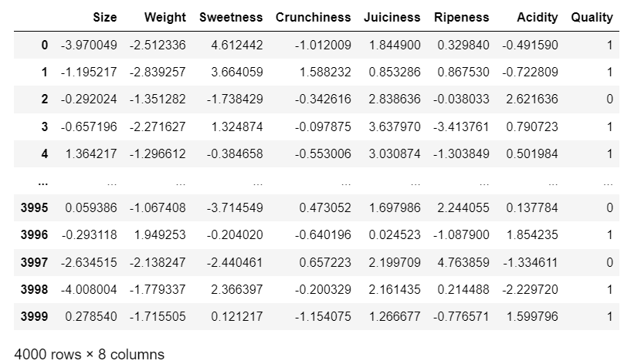
D
A
T
A
S
E
T
S
U
M
M
A
R
Y
The "Apple Quality Dataset" provided by AAC serves as a comprehensive repository of valuable information pertaining to various attributes of apples.
This dataset encompasses crucial factors such as fruit ID, size, weight, sweetness, crunchiness, juiciness, ripeness, acidity, and overall quality.
Each attribute plays a vital role in determining the overall quality and marketability of apples, making this dataset an invaluable resource for research and analysis in the agricultural domain.

Slide 5
Our project aims to harness the power of machine learning to develop predictive models for apple quality assessment.
By utilizing the rich insights offered by the Apple Quality Dataset, we seek to enhance our understanding of the factors influencing apple quality and optimize the decision-making process in fruit cultivation and distribution

Slide 6
Machine learning serves as a cornerstone of our approach to apple quality assessment, enabling us to analyze vast quantities of data and extract meaningful patterns and trends
I utilized various classification algorithms, including logistic regression, support vector machine (SVM), F1 score, random forest, decision tree, K-nearest neighbors (KNN), and naive Bayes, to assess the accuracy of classification tasks .

Slide 7

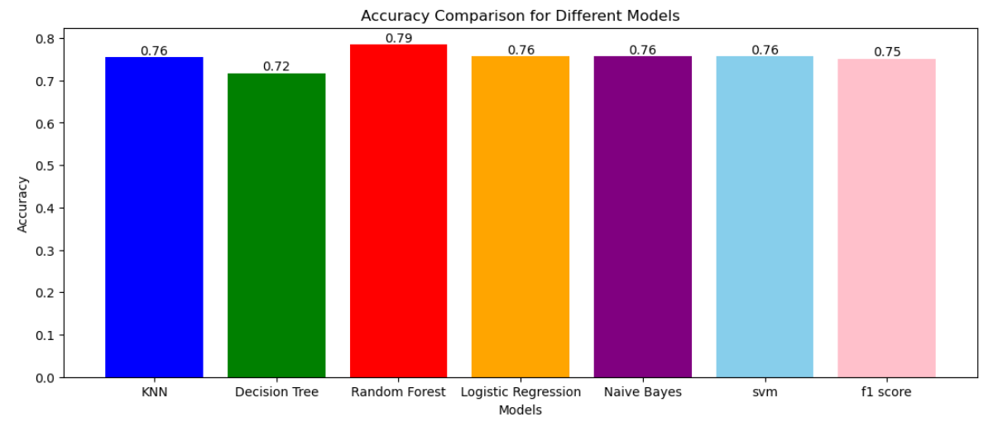

Slide 8
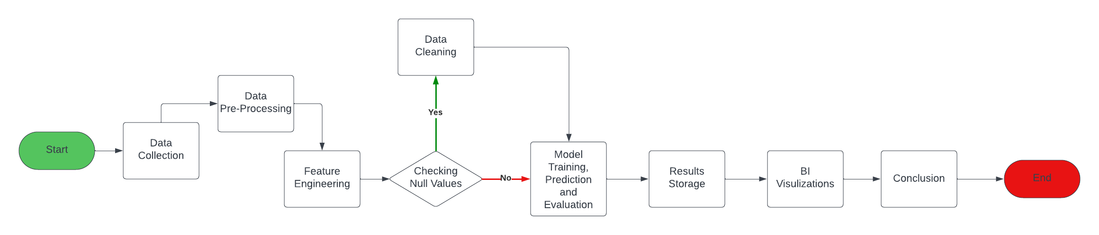

Slide 9
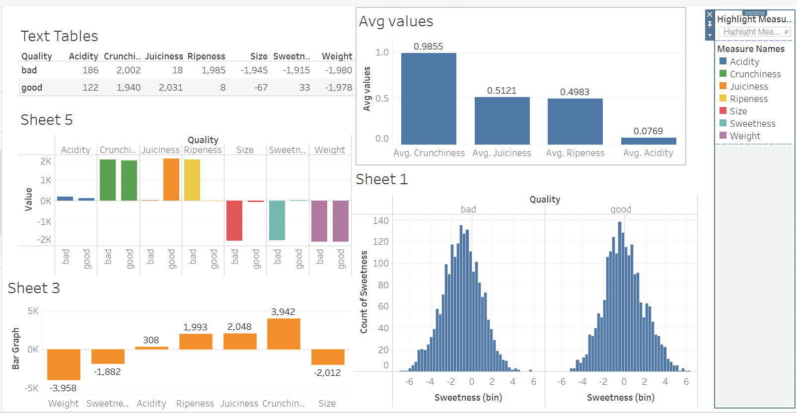

Slide 10
In conclusion, My journey into the realm of apple quality assessment has provided valuable insights into the intricacies of fruit evaluation and its implications for the agricultural industry.
Through collaboration with AAC and leveraging the rich insights offered by the Apple Quality Dataset, we have laid the foundation for future advancements in fruit quality assessment and optimization.

Slide 11


